Slide 1
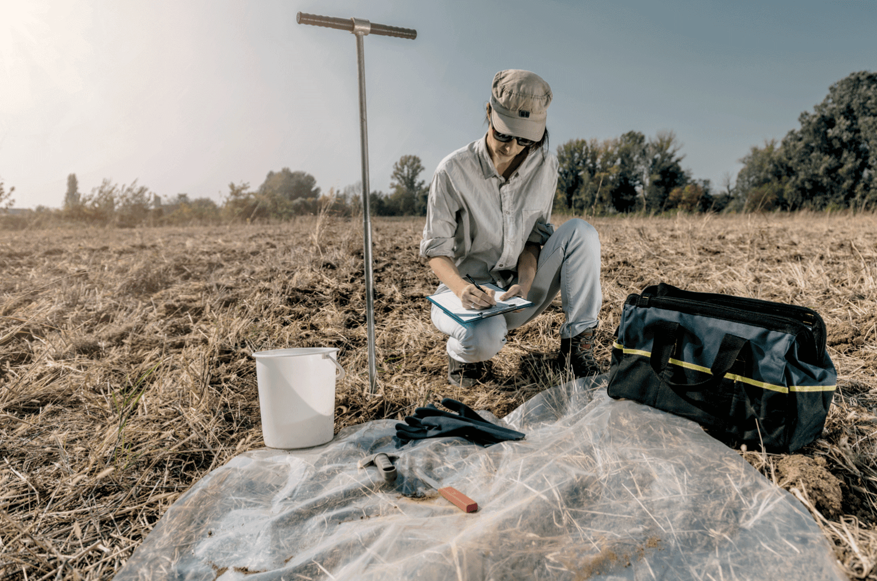
Assessment of lab performance: single blind and double blind
Robert O. Miller, PhD
ALP Technical Director
Windsor, CO
Rmiller@soiltesting.us
MASTPAWG Meeting
February 22, 2023
Notes:
Intro slide
Soil pH is the negative log of the H ion concentration and an indicator of soil acidity or alkalinity. This is the key note for this S4-S8 session.

Slide 2
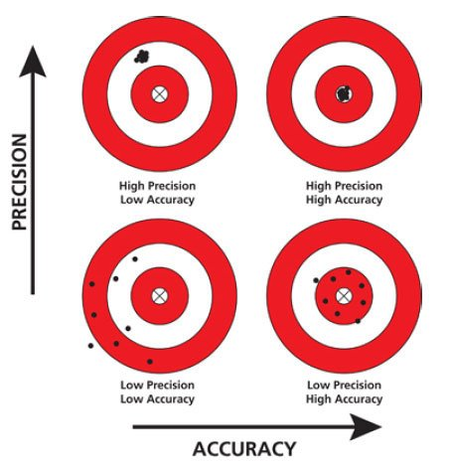
Background
Soil analysis is an integral component of nutrient management decisions and the basis of fertilizer and lime recommendations across the United States.
An estimated 11 million soil samples were collected across the US in 2020 for the determination of pH, lime requirements, P, K, Ca, Mg, micronutrients and SOM analysis.
Critical to the assessment of soil fertility, is the accuracy and consistency of laboratory soil test analysis results.
How do we assess lab quality?
https://growers.ag/wp-content/uploads/2021/03/SoilCollectionHandSampling-1.png
MASTPAWG Meeting
D-Blind Laboratory Presentation
February 22, 2023
Miller, 2023

Slide 3
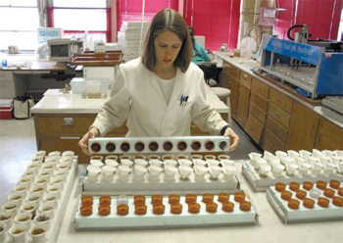
Definitions
Assessment of lab performance, two methods:
Single-Blind study: an assessment of lab analytical performance through the submission of known proficiency samples, but of unknown analysis.
Double-Blind study: an assessment of lab performance whereby the both the submitter of the samples and the analysis concentrations are unknown to the laboratory. Assessment of the whole process: receiving, processing and analysis.
http://www.waldeneffect.org/20111008samplingsoil.jpg
Represents the
labs best quality
Represents the
labs actual quality
Over the past four years five lab double-blind assessment studies have been conducted across the US to evaluate laboratory analysis accuracy and consistency of routine soil test parameters.
MASTPAWG Meeting
D-Blind Laboratory Presentation
February 22, 2023
Miller, 2023

Slide 4
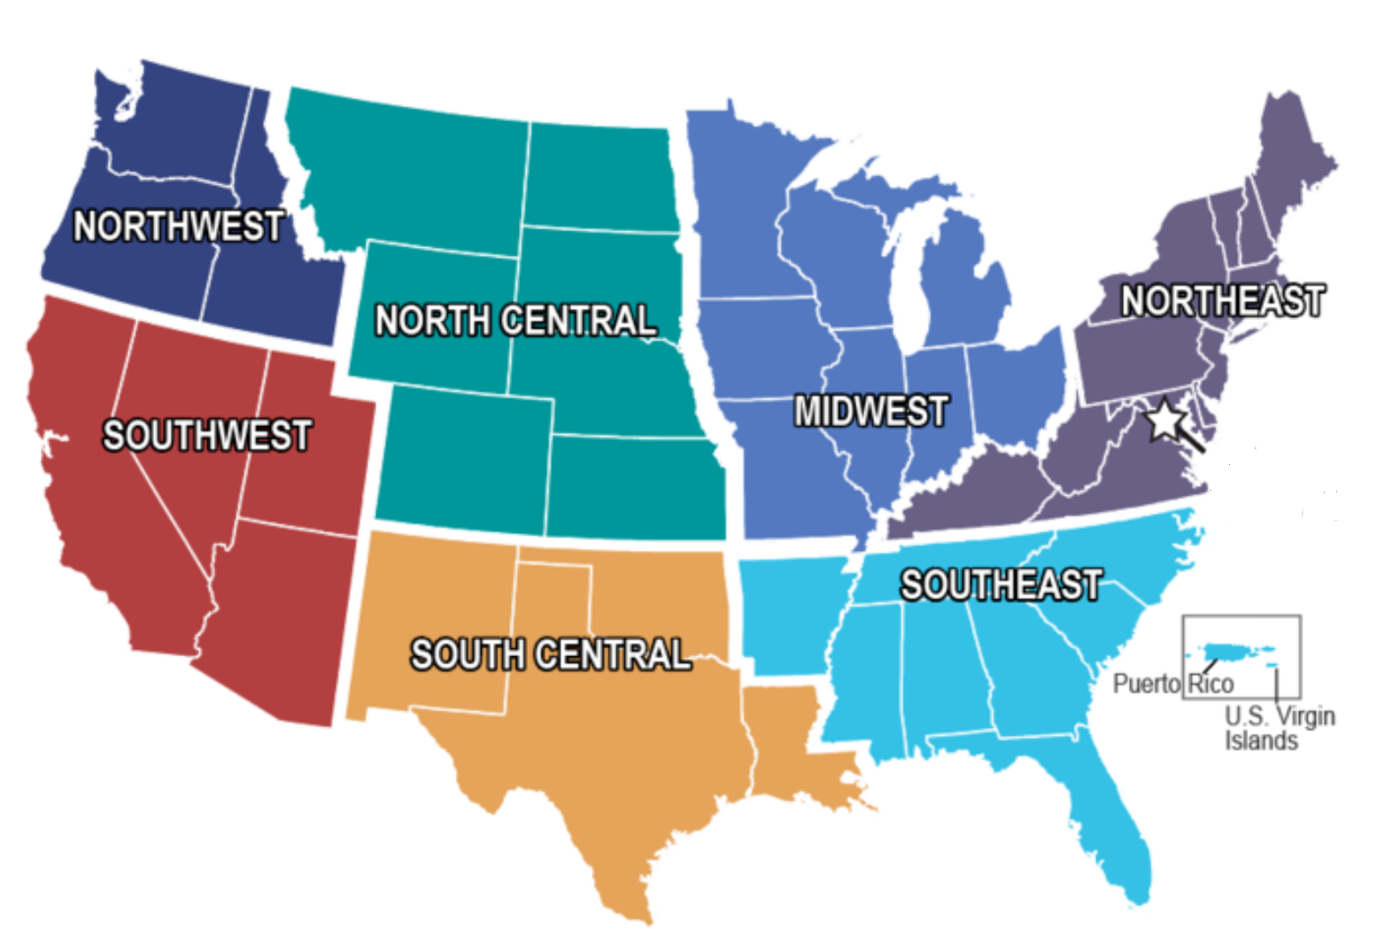
Lab D-Blind studies
Five soil testing laboratory D-blind assessment studies have been conducted across the US.
- 2018, eight California labs
- 2019, seven Iowa labs
- 2019, five Southeast labs
- 2021, six Northwest labs
- 2022, four California labs
Presentation will be limited to two of the primary D-blind studies
D-Blind studies utilized multiple ALP standard reference soils submitted to testing labs through surrogate clients.
https://www.google.com/url?sa=i&url=https%3A%2F%2Fwww.usgs.gov%2Fmedia%2Fgalleries%2Fclimate-adaptation-science-center-individual-region-maps&psig=AOvVaw3ZgjyGHvAKjOO3wwPdIrU0&ust=1675957062478000&source=images&cd=vfe&ved=0CA8QjRxqFwoTCNCyxNyghv0CFQAAAAAdAAAAABAE
MASTPAWG Meeting
D-Blind Laboratory Presentation
February 22, 2023
Miller, 2023

Slide 5
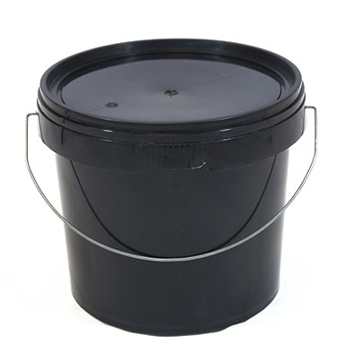
California D-Blind study 2018
Through a grant from The California Dept of Food and Agriculture Fertilizer Research and Education Program a double-blind assessment of soil testing labs was initiated in California. Research conducted by Andre Biscaro, UCCE Ventura, Cty, and CA Robert O. Miller, ALP Program.
8 Laboratories
A
B
SRS-1809
SRS-1714
3 times
(Dec 2018, Apr and June 2019)
C
D
SRS-1604
SRS-1610
Basic soil fertility
Four soils from the ALP archive were re-aggregated as cores with DI water, dried and submitted with a field ID through surrogate clients to eight labs serving California.
NO₃-N, P, X-K, X-Na, X-Ca, X-Mg, SO₄-S, CEC (est), pH, SPE (ECe, Cl, Ca, Mg, Na and B), DTPA Zn, Mn, Cu.
MASTPAWG Meeting
D-Blind Laboratory Presentation
February 22, 2023
Miller, 2023
Notes:
precision (uncertainty of the soil test within a laboratory) of the results and if there is inconsistency over time.

Slide 6
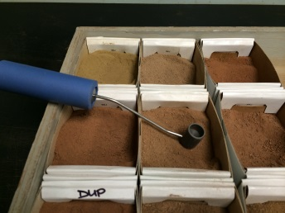
D-Blind standard reference soils
Properties of 4 soils used for the D-Blind study, (medians):
pH (1:1): 5.52 – 7.80 Olsen P: 10.2 – 26.2 mg kg⁻¹
Buf pH: 6.89 – 7.55 STK (Ac): 95 – 489 mg kg⁻¹
Standard reference soils of known analysis¹, based on ALP inter-laboratory median and 95% confidence limits, where:
Median Absolute Deviation:
MAD = ∑ │x_{i} - x│/n
~
Confidence Limits 95%: Median ± (2.9 x MAD)
Laboratories were assigned a numeric code for anonymity.
MASTPAWG Meeting
D-Blind Laboratory Presentation
February 22, 2023
Miller, 2023

Slide 7
California D-Blind study: pH
Soil SRS-1604
Consistent
high bias
pH _{(1:1) H2O}
Upper Limit
Median
Lower Limit
Andre Biscaro, UCCE Ventura, Cty, CA
¹ Median and 95% confidence limits based on ALP reference soil analysis results.
MASTPAWG Meeting
D-Blind Laboratory Presentation
February 22, 2023
Miller, 2023

Slide 8
California D-Blind study: Olsen P
Soil SRS-1809
Consistent
high bias
Soil Olsen P (ppm)
Upper Limit
Median
Lower Limit
Andre Biscaro, UCCE Ventura, Cty, CA
¹ Median and 95% confidence limits based on ALP reference soil analysis results.
MASTPAWG Meeting
D-Blind Laboratory Presentation
February 22, 2023
Miller, 2023

Slide 9
California D-Blind study: K
Soil SRS-1604
Upper Limit
Median
Soil K (ppm)
Lower Limit
Andre Biscaro, UCCE Ventura, Cty, CA
¹ Median and 95% confidence limits based on ALP reference soil analysis results.
MASTPAWG Meeting
D-Blind Laboratory Presentation
February 22, 2023
Miller, 2023

Slide 10
California S-Blind vs D-Blind: K
Soil SRS-1604
Upper Limit
Median
Soil K (ppm)
Lower Limit
Laboratory
Andre Biscaro, UCCE Ventura, Cty, CA
¹ Median and 95% confidence limits based on ALP reference soil analysis results.
MASTPAWG Meeting
D-Blind Laboratory Presentation
February 22, 2023
Miller, 2023

Slide 11
California D-Blind study summary
Generally, D-blind reproducibility of reference soil pH and Olsen-P were consistent across labs and month of submission for three of four soils. One lab provided consistent high bias P results for all 4 soils.
D-Blind K results were highly reproduceable over the three submissions for five of eight labs. One lab was inconsistent across the three submissions.
Results for SRS-1604 indicate all S-blind soil K results were within confidence limits, whereas only 4 of 8 lab D-blinds results were within CL. Similar trends were noted for the three other soils.
A D-Blind assessment provides an impartial appraisal of lab bias and insight on consistency.
MASTPAWG Meeting
D-Blind Laboratory Presentation
February 22, 2023
Miller, 2023

Slide 12
Iowa D-Blind lab study 2019
Background. Approximately 1.1 million soil samples are analyzed by seven labs across Iowa annually with 70% analyzed during the fall rush (Sept – Dec). Daily lab volume range from 1,000-30,000 samples per day.
In 2019 the Iowa Nutrient Research and Education Council (NREC) initiated a D-blind study of Iowa soil testing labs, over analysis quality concerns.
A study was initiated to assess laboratory performance utilizing a D-blind assessment through the fall of 2019, using standard reference soils.
MASTPAWG Meeting
D-Blind Laboratory Presentation
February 22, 2023
Miller, 2023
Notes:
precision (uncertainty of the soil test within a laboratory) of the results and if there is inconsistency over time.

Slide 13
Iowa D-Blind lab study 2019
Six soils were selected from Agriculture Laboratory Proficiency¹ archive, soils were re-aggregated, dried, packaged and submitted through surrogate clients to 7 Iowa soil test laboratories as D-blind samples over three consecutive months.
7 Iowa laboratories
A
B
SRS-1403
SRS-1515
D
3 times
(Oct, Nov, Dec 2019)
C
SRS-1612
SRS-1804
Basic soil fertility
pH, Buf pH, P, K, Ca,
Mg, S, SOM, CEC and Zn
E
F
SRS-1814
SRS-1910
¹ Funded by: Iowa Nutrient Research and Education Council.
MASTPAWG Meeting
D-Blind Laboratory Presentation
February 22, 2023
Miller, 2023
Notes:
precision (uncertainty of the soil test within a laboratory) of the results and if there is inconsistency over time.

Slide 14
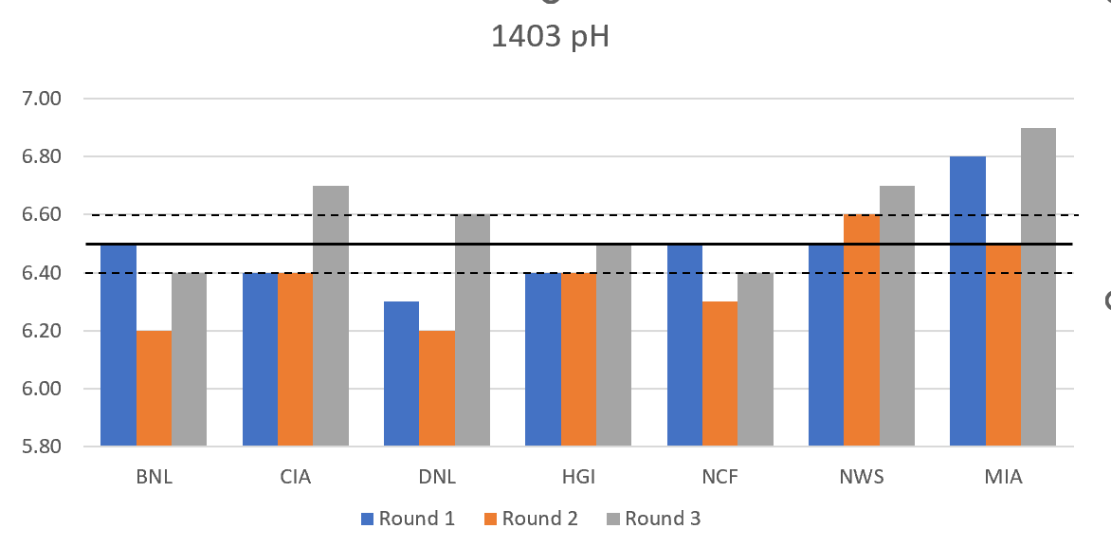
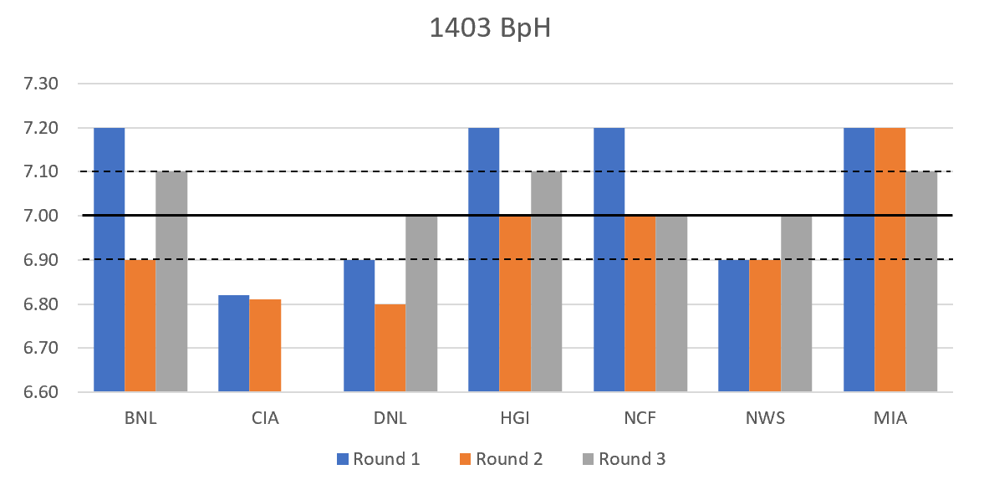
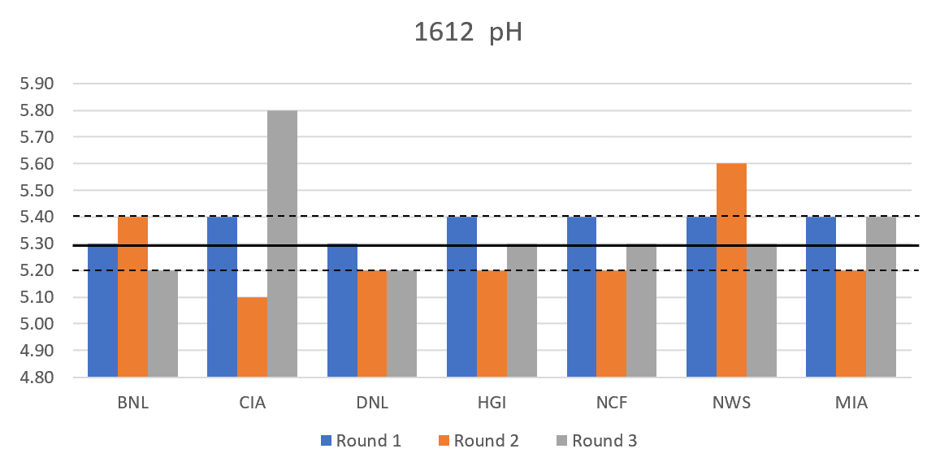
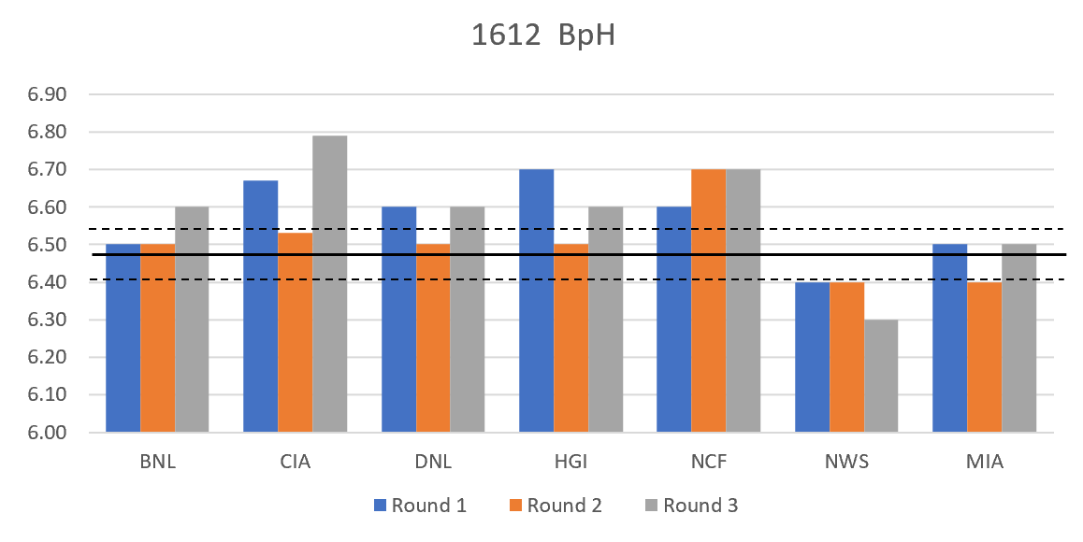
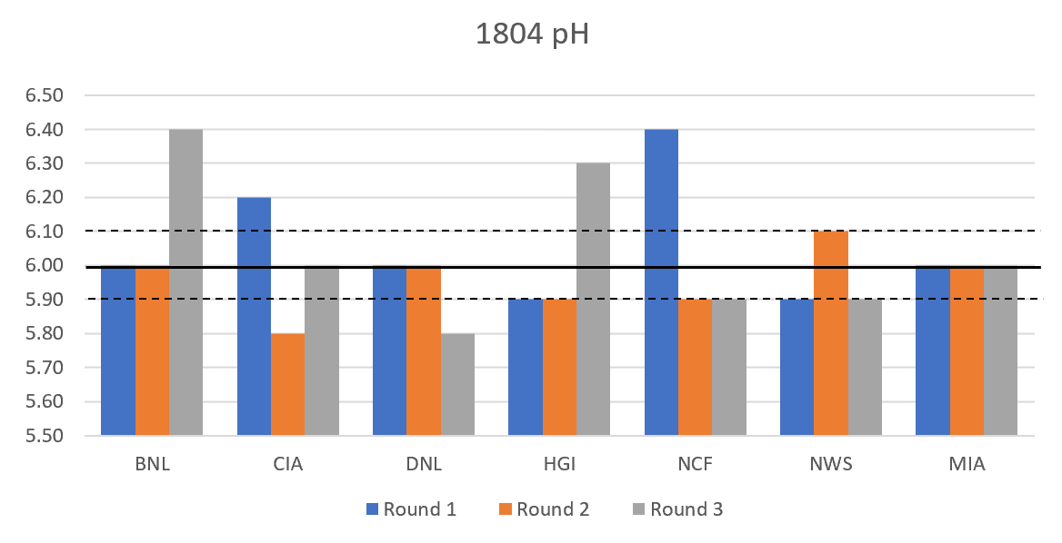
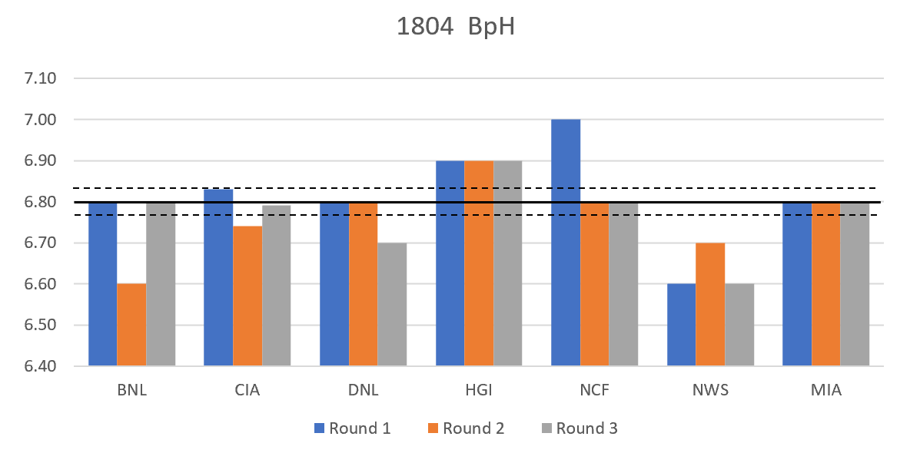
Iowa D-Blind lab study 2019
The Iowa study generated an extensive amount of data, seven laboratories, six soils, three dates of submission, a total of 126 measurements across fourteen soil parameters.
Data was sorted based on soil ID, Laboratory and date of submission. Lab performance was evaluated based on standard reference soil median and 95% confidence limits.
Lab consistency was assessed based on reproducibility over three months for each test method.
MASTPAWG Meeting
D-Blind Laboratory Presentation
February 22, 2023
Miller, 2023

Slide 15
Iowa D-Blind lab study results: pH and K
pH (1:1)
Soil Test K
Outliers
Inconsistency
¹ Median and 95% confidence limits based on ALP analysis results.
MASTPAWG Meeting
D-Blind Laboratory Presentation
February 22, 2023
Miller, 2023

Slide 16
Iowa S-Blind vs D-Blind
Comparison of S-blind vs D-blind assessment of seven Iowa labs of soil K and Bray P1, for soil SRS-1403, at left.
K S-blind results indicate 4 of 7 labs results within confidence limits (CL), whereas for D-blind results, 3 of 7 were within CL.
P S-blind results indicate 5 of 6 results were within CL, whereas for D-blind results, only 4 of 7 results within CL.
Median
K (ppm)
Laboratory
Bray P1 (ppm)
Median
¹ Single blind lab results from ALP cycle 23.
Laboratory
MASTPAWG Meeting
D-Blind Laboratory Presentation
February 22, 2023
Miller, 2023

Slide 17
Iowa D-Blind lab study: pH and Buf pH
pH (1:1)
Buf pH (Sikora)
Inconsistent
¹ Median and 95% confidence limits based on ALP analysis results.
MASTPAWG Meeting
D-Blind Laboratory Presentation
February 22, 2023
Miller, 2023

Slide 18
Iowa D-Blind lab study : Buf pH and Cost
Buf pH (Sikora)
Lime Cost $/ac
High
bias
Recommendation over applied lime
Recommendation under applied lime
Costs based on ISU Recommendation Guidelines. https://store.extension.iastate.edu/product/A-General-Guide-for-Crop-Nutrient-and-Limestone-Recommendations-in-Iowa, and price of $50/ton for lime.
MASTPAWG Meeting
D-Blind Laboratory Presentation
February 22, 2023
Miller, 2023

Slide 19
Iowa D-Blind lab study : P and Cost
STP (Bray P1)
P₂O₅ (18-46-0) Cost $/ac
High
bias
Recommendation under applied P fertilizer
Costs based on ISU Recommendation Guidelines. https://store.extension.iastate.edu/product/A-General-Guide-for-Crop-Nutrient-and-Limestone-Recommendations-in-Iowa, and price of $50/ton for lime and $475/ton for 18-46-0.
MASTPAWG Meeting
D-Blind Laboratory Presentation
February 22, 2023
Miller, 2023

Slide 20
D-blind additional observation
Double-Blind proficiency study: an assessment of lab performance whereby the both the submitter of the samples and the analysis concentrations are unknown to the laboratory. Assessment of the entire lab process: receiving, processing and analysis.

Slide 21
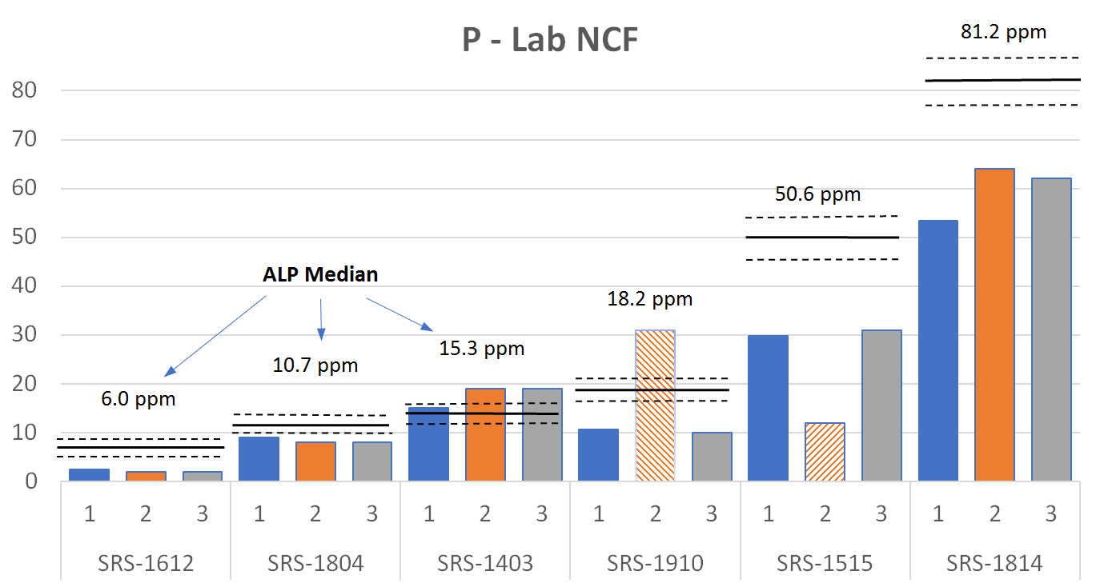
Iowa soil test lab study : Lab NCF
Login failure
Bray P1 (ppm)
Soil ID
¹ Median and confidence limits based on ALP reference soil analysis results, consensus of 108 laboratories analysis of each soil in triplicate.
MASTPAWG Meeting
D-Blind Laboratory Presentation
February 22, 2023
Miller, 2023

Slide 22
D-Blind study: assessing performance
D-blind laboratory performance was evaluated for each of the six soils based on pH, Buf, pH, P and K test parameters, for each lab, by month.
Lab analysis results within ± 95% confidence limits of the standard reference soil median were used to calculate proficiency scores by soil and method, and scores tabulated by laboratory and month of submission.
Lab score = ∑ (4 parameters and 6 soils)
MASTPAWG Meeting
D-Blind Laboratory Presentation
February 22, 2023
Miller, 2023

Slide 23
D-Blind lab proficiency assessment
Lab proficiency was assessed for each lab across the six soils for soil pH, Buf pH, P and K.
Lab ID | 2019 Iowa Lab Proficiency (%)
 | October | November | December | Mean
BNL | 95.0 | 75.0 | 70.8 | 80.6
CIA | 87.5 | 70.8 | 39.1 | 65.8
DNL | 96.0 | 75.0 | 76.8 | 80.6
HGI | 95.8 | 83.3 | 79.2 | 86.1
NCF | 95.8 | 62.5 | 75.0 | 77.8
NWS | 95.0 | 62.5 | 58.2 | 72.2
MIA | 87.5 | 70.8 | 45.6 | 68.1
Mean | 93.2 | 71.4 | 63.5
MASTPAWG Meeting
D-Blind Laboratory Presentation
February 22, 2023
Miller, 2023

Slide 24
Summary S-blind vs D-blind
Across 2018 and 209 studies, S-blind lab proficiency performance results were higher than D-blind results, based on percentage of lab results within confidence limits, across soils and parameters evaluated.
S-blind evaluations are known proficiency samples, and likely subject to greater lab scrutiny and attention. Additionally, S-blind evaluations do not include lab receiving and soil preparation steps.
D-blind lab evaluations, are more indicative to “actual” lab sample analysis processing and an assessment of performance.
Temporal submissions of D-blind lab proficiency samples provide an assessment of intra-lab method precision, and insight on quality control performance through a season.

Slide 25
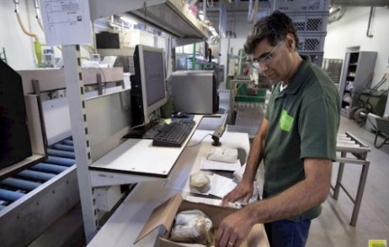
D-blind summary
Generally, pH test reproducibility was consistent across labs and months of submission for the two D-blind lab studies.
D-blind soil extractable P results for both California and Iowa studies were generally consistent across laboratories and over dates of submission for a majority of soils.
Soil extractable K D-blind results for the six soils evaluated indicated 80% of Iowa labs were consistent through the fall of 2019.
MASTPAWG Meeting
D-Blind Laboratory Presentation
February 22, 2023
Miller, 2023

Slide 26
Summary (Cont)
Most troubling were specific Iowa labs with inconsistent measurement over time for Buf pH used in lime recommendations. Specific labs intra-lab Buf pH variance exceeded 0.5 pH units, impacting lime cost. Low bias Buf pH for SRS-1804 increased lime cost > $50/ac for two labs.
One IA laboratory incorrectly logged in D-blind soils for one submission, thus reporting incorrect results across all analyses.
Averaged over soil test methods, IA laboratory proficiency declined through the fall of 2019 with mean proficiency scores of 93.2% 74.4% and 63.5%, respectively. Declines in performance were attributed to seasonal staff fatigue.
MASTPAWG Meeting
D-Blind Laboratory Presentation
February 22, 2023
Miller, 2023

Slide 27
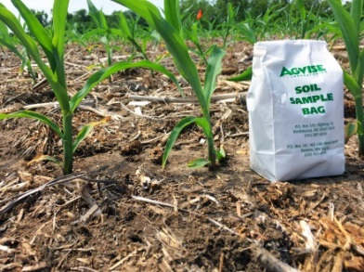
Quality concerns
Poor D-blind reproducibility of Buf pH over time.
Degradation of Iowa lab performance quality through the fall.
Both concerns can be sourced to: the method SOP; QC implementation; and lab management.
Temporal changes in Buf pH reproducibility across multiple soils indicates an ineffective QC system.
Lab performance quality should be consistent through the sample processing season. Across the lab industry management should address the method SOP and seasonal workload staffing.
MASTPAWG Meeting
D-Blind Laboratory Presentation
February 22, 2023
Miller, 2023

Slide 28
Follow-up
Results of the Iowa D-blind study were presented to each lab participant and shared with the Iowa Nutrient Research and Education Council (NREC).
Iowa NREC met with lab participants September 15, 2022 to review D-Blind results and discuss lab quality. As a result Iowa NREC and the Agriculture Laboratory Testing Association (ALTA), have initiated a certification program for soil testing labs serving Iowa based on D-blind evaluation.
The program is based on three D-blind labs evaluations, submitted spring and fall 2023. The program is provisional for 2023.
Enrollment information can be found at ALTA.AG
MASTPAWG Meeting
D-Blind Laboratory Presentation
February 22, 2023
Miller, 2023

Slide 29
3- Questions
How good is your lab’s soil analysis quality?
Is it consistent through the course of the year?
If yes, do you have data to support your conclusion?
MASTPAWG Meeting
D-Blind Laboratory Presentation
February 22, 2023
Miller, 2023

Slide 30
Thank you for your time
and attention
E-mail:
Robert.Miller@cts-interlab.com
Txt: 970-217-2572

Slide 31
California D-Blind study: K
Soil SRS-1610
Upper Limit
Soil K (ppm)
Median
Lower Limit
¹ Median and 95% confidence limits based on ALP reference soil analysis results.
Andre Biscaro, UCCE Ventura, Cty, CA
MASTPAWG Meeting
D-Blind Laboratory Presentation
February 22, 2023
Miller, 2023

Slide 32
Summary lab evaluation
Soil pH was generally reproducibility across dates of submission and labs however, Buf pH reproducibility issues resulted in variable lime cost for four of seven labs.
Bias low STP resulted over application of P fertilizer and increased cost, noted in two of seven labs for one soil. High STP bias in three labs resulted in under fertilization and lost yield for one soil.
Across labs and dates STK was more consistent in 2019 than 2020, likely associated with differences soil collection. Six lab STK method failures (17%) were noted in 2020 across the six soils.
Lab proficiency average 76% across six soils and four methods in 2019.
IA NREC Meeting
Lab Results Presentation
April 1, 2021
Miller, 2021

Slide 33
Iowa study: Recommendation cost
Soil ID SRS-1910
$77
Cost $/ac
Costs based on ISU Recommendation Guidelines. https://store.extension.iastate.edu/product/A-General-Guide-for-Crop-Nutrient-and-Limestone-Recommendations-in-Iowa, and prices based on 2020 costs for lime, 18-46-0 and 0-0-60.
MASTPAWG Meeting
D-Blind Laboratory Presentation
February 22, 2023
Miller, 2023

Slide 34
Iowa S-Blind vs D-Blind: K
Soil SRS-1403
Upper Limit
Median
Soil K (ppm)
Lower Limit
Laboratory
MASTPAWG Meeting
D-Blind Laboratory Presentation
February 22, 2023
Miller, 2023

